Slide 1
Discount Shuttle
By Captain Teemo
Team member:
UI designer: Jiyu Shi
Model designer: Zhongao Tang
Database designer: Xiaoyu Wang

Slide 2
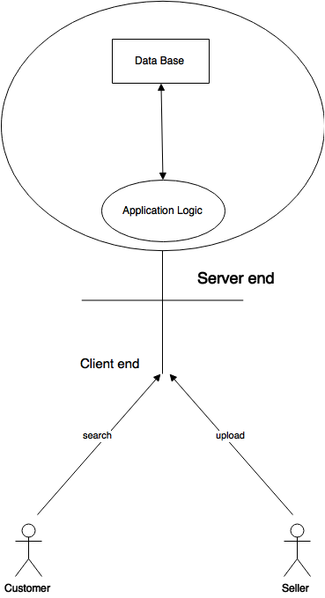
Project Overview：
Generally speaking, Discount Shuttle is designed to collect discount information for customer they are interested in, and to build a platform for seller to attract customer. As a seller, one can simply post the discount information combined with their shop’s location, those data will be send and stored in our server, which is a tomcat server running by a laptop. On the other hand, Discount shuttle allows customer to find their interested discount information close to them. They can get details about the product, the shop, even the way lead to the shop. This idea was generated one day I hang out for dinner with my friends in south side and find a supermarket named ALDI accidentally. I find most of the items there are in discount and nearly half price of those in Giant Eagle where I used to shop. As a student without income, I consider that those information especially discount information can be very important to people like me. they can save lots of money and buy high quality products on the same time.

Slide 3
Product Walk through
Below are the screen shots of the use case

Slide 4
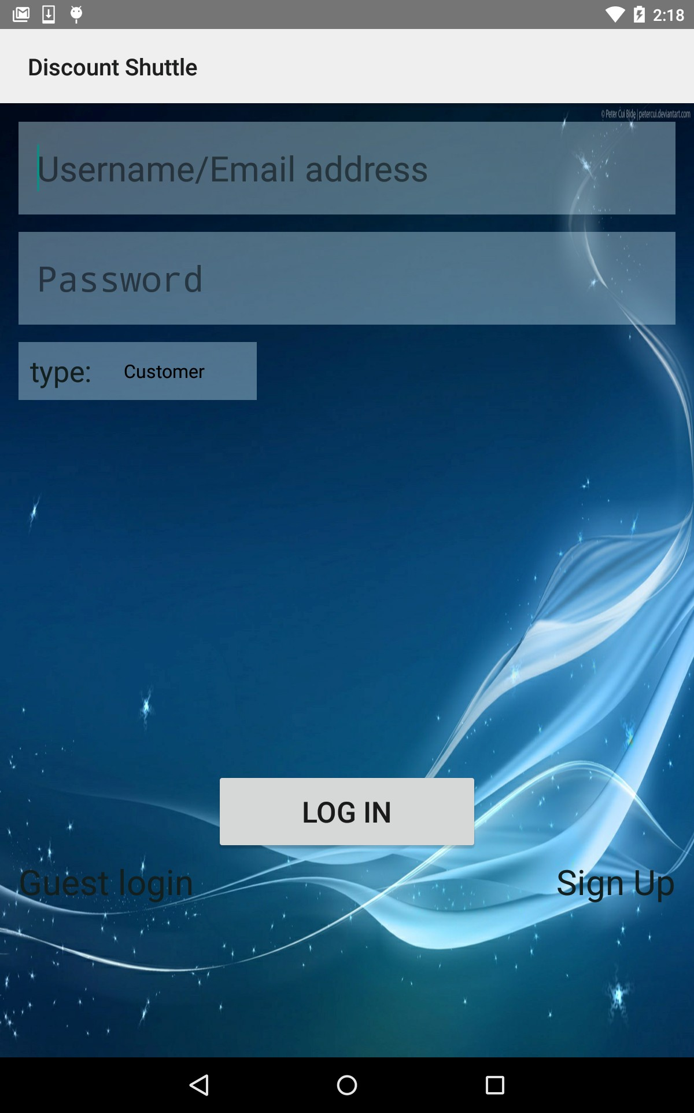
1.Main page:

Slide 5
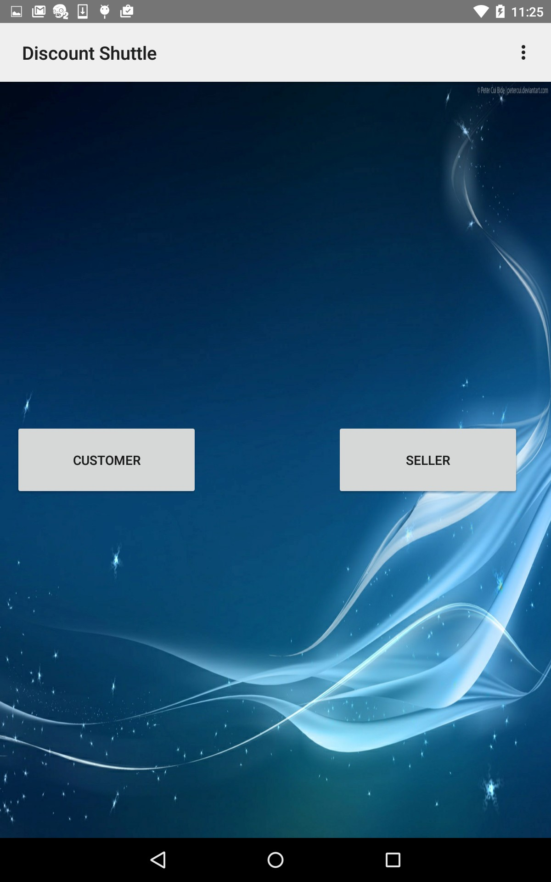
2.Main sign up page:

Slide 6
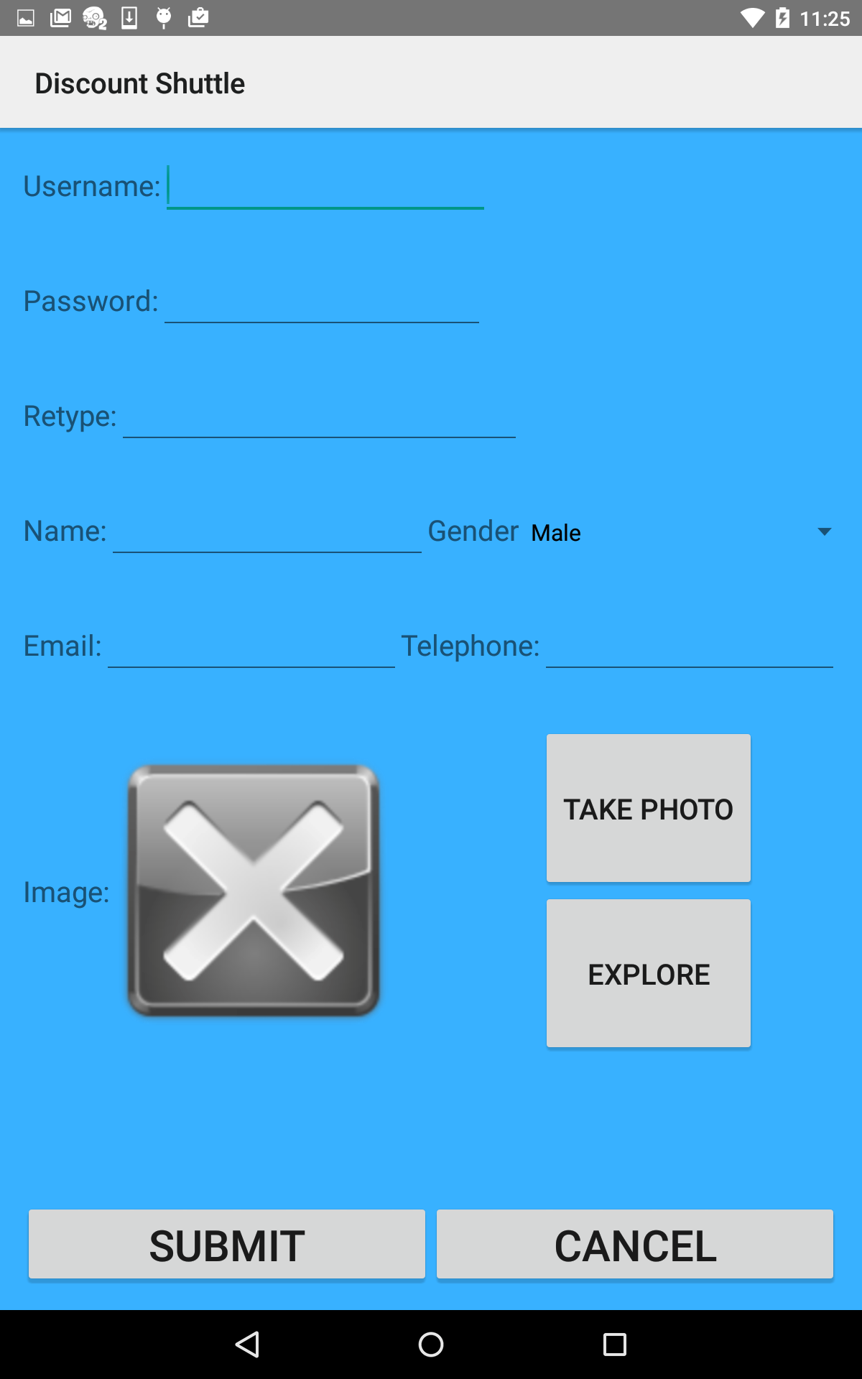
3.Customer sign up page:

Slide 7
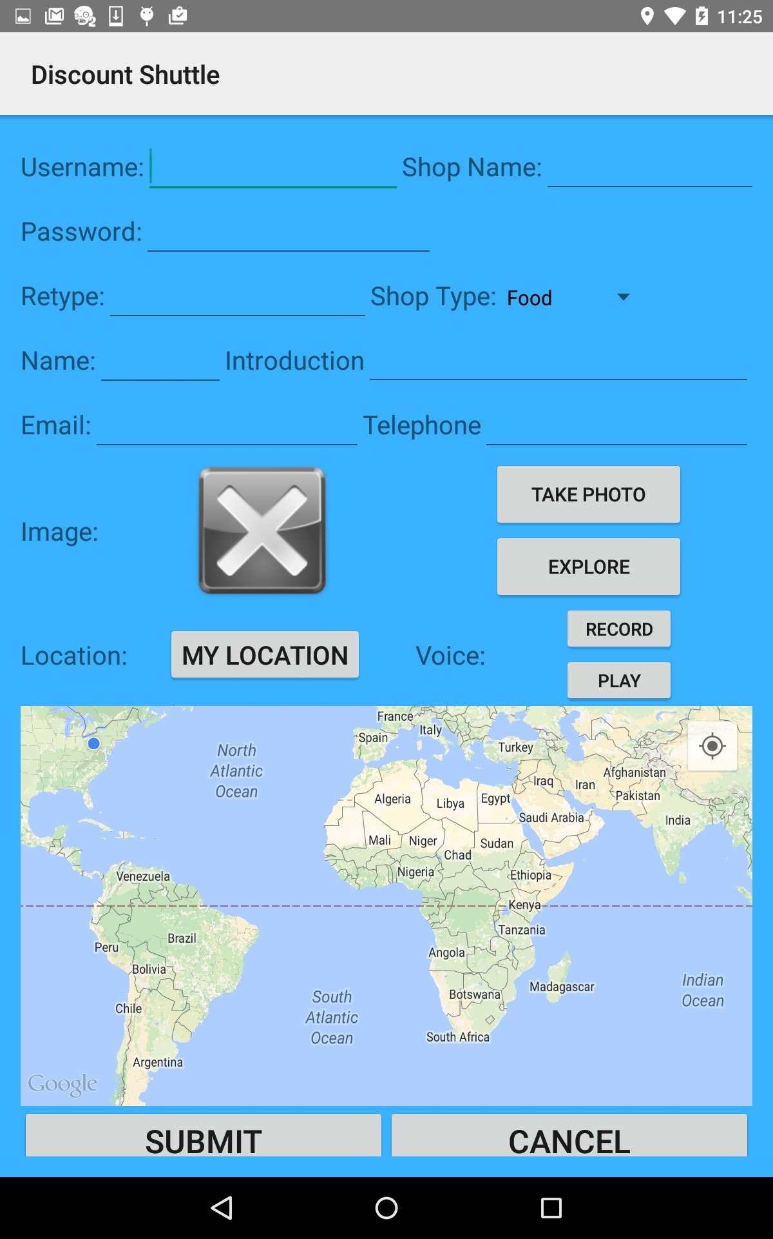
4.Seller sign up page:

Slide 8
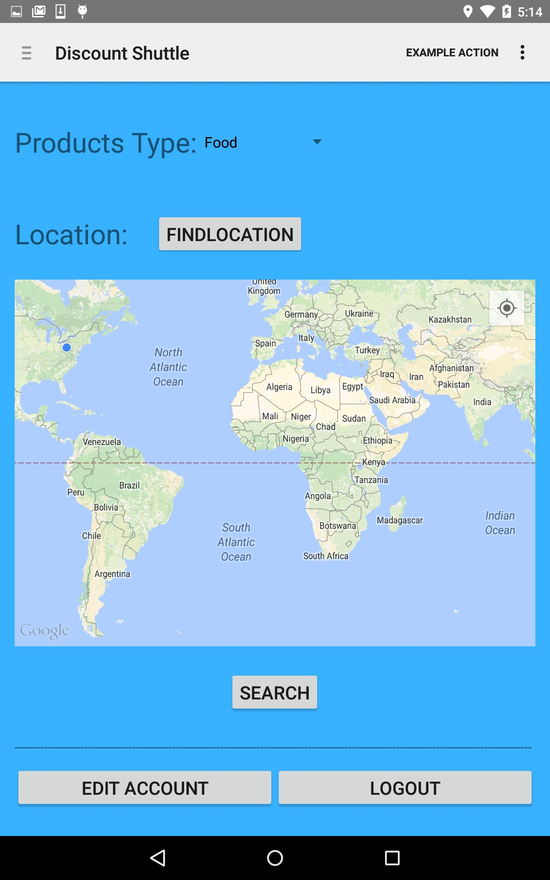
5.Customer main page:

Slide 9
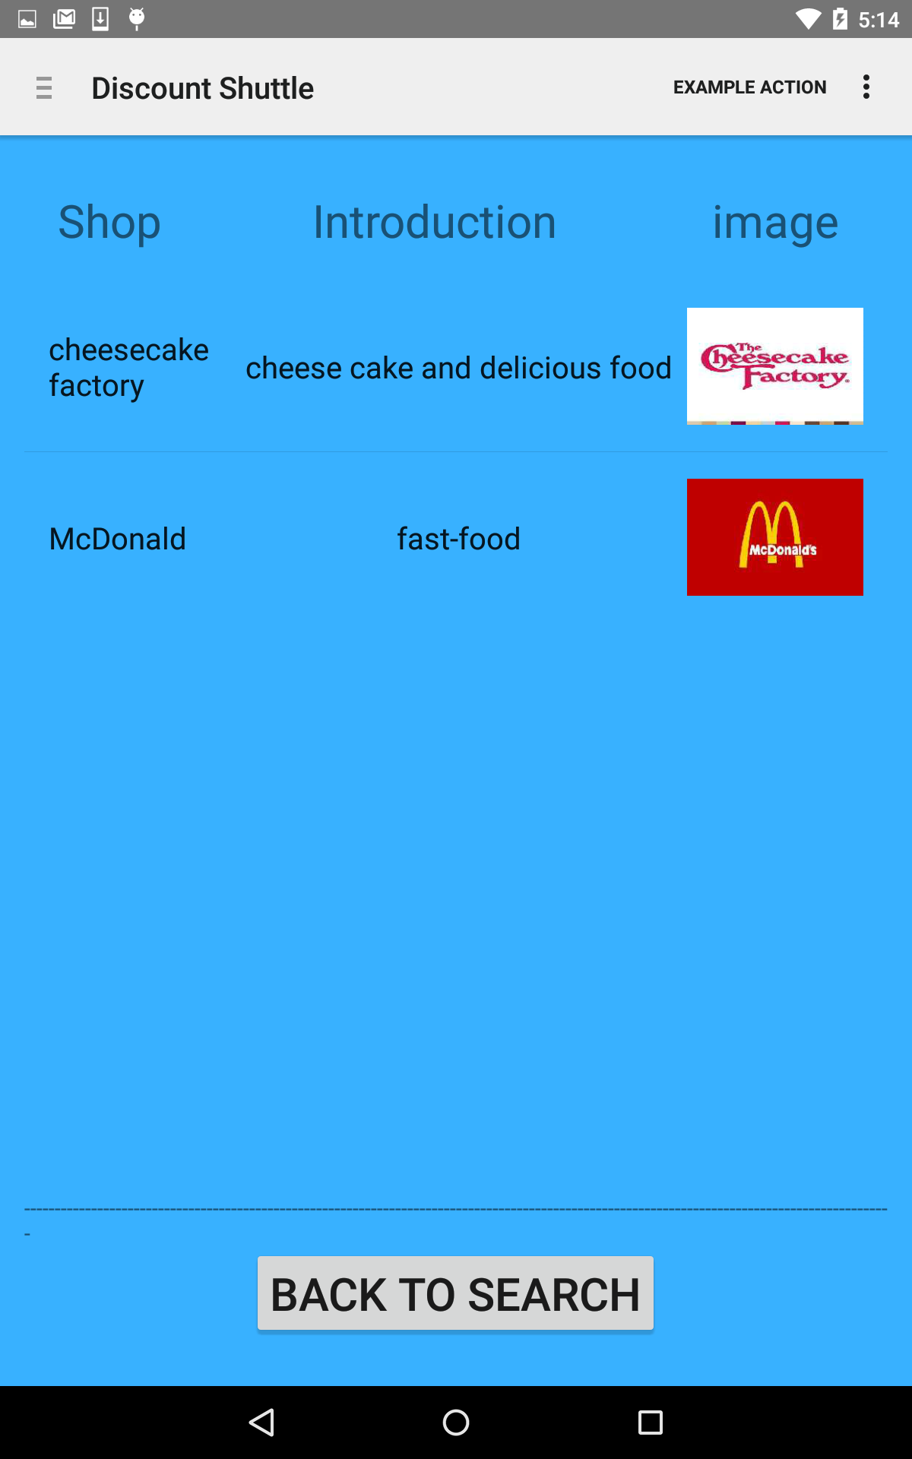
6.Customer search outcomes page:(guest)

Slide 10
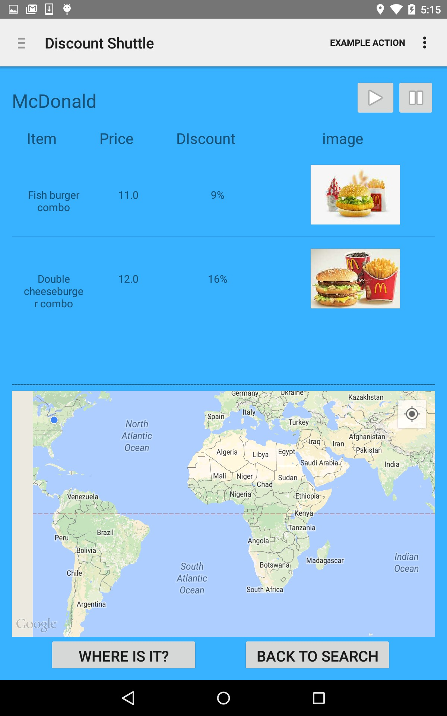
7.Customer search detail page: (guest)

Slide 11
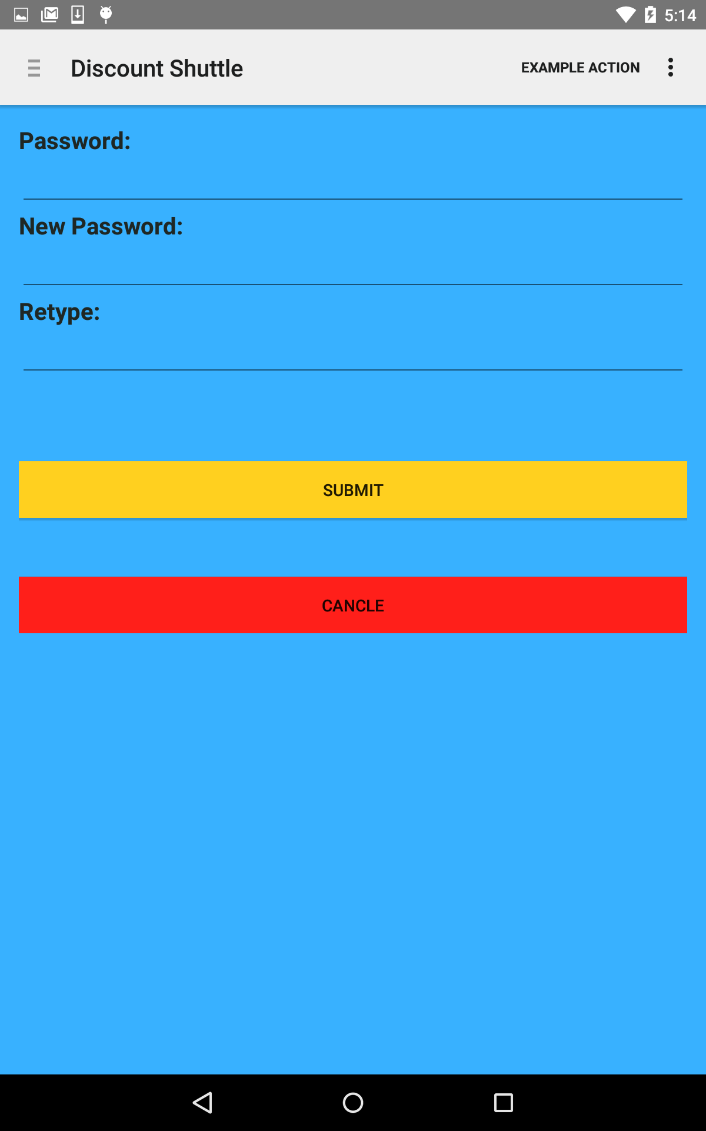
8.Customer change password page: (seller)

Slide 12
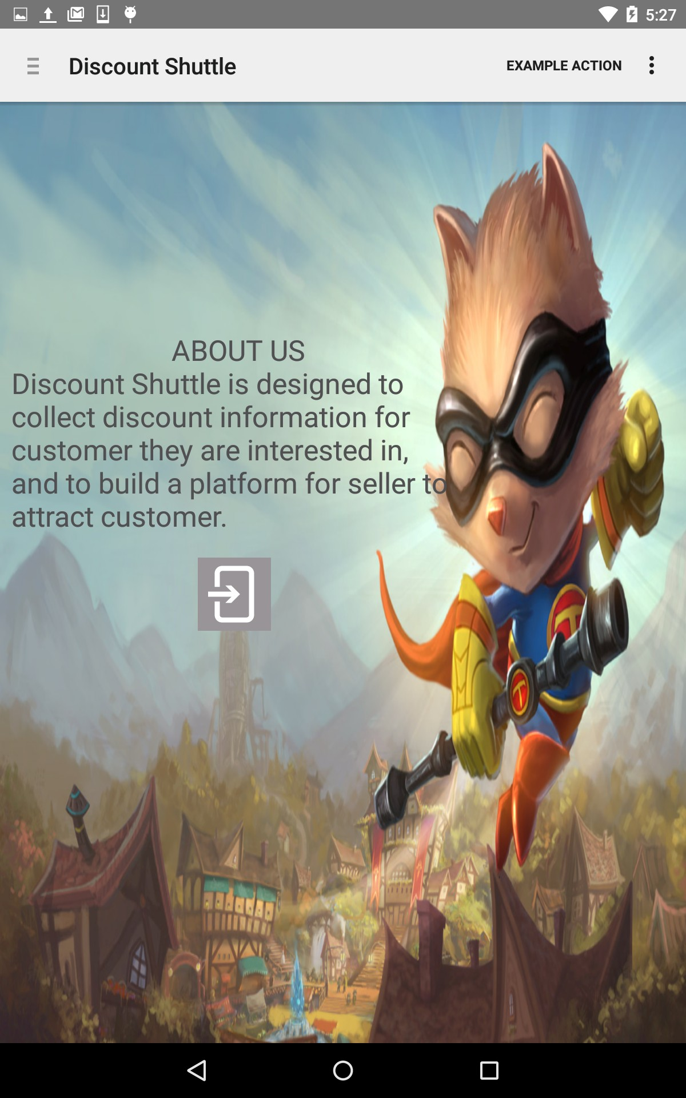
9.Customer About us page:

Slide 13
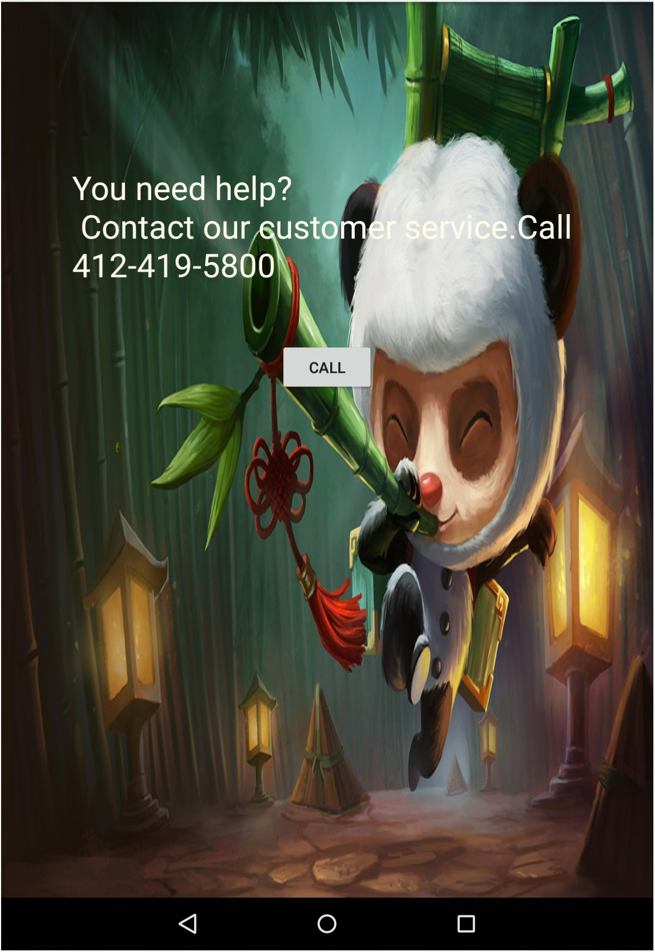
10.Customer help page:
i.;J .!. ~ 0 •
• D s:21

Slide 14
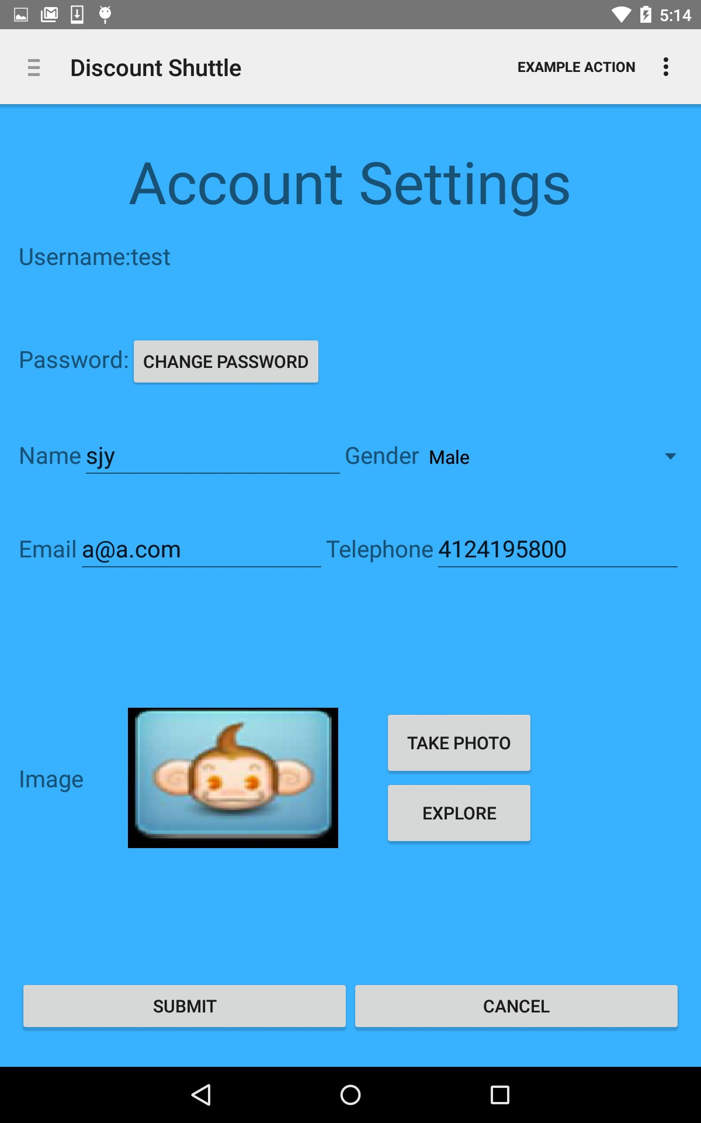
11.Customer Account page:

Slide 15
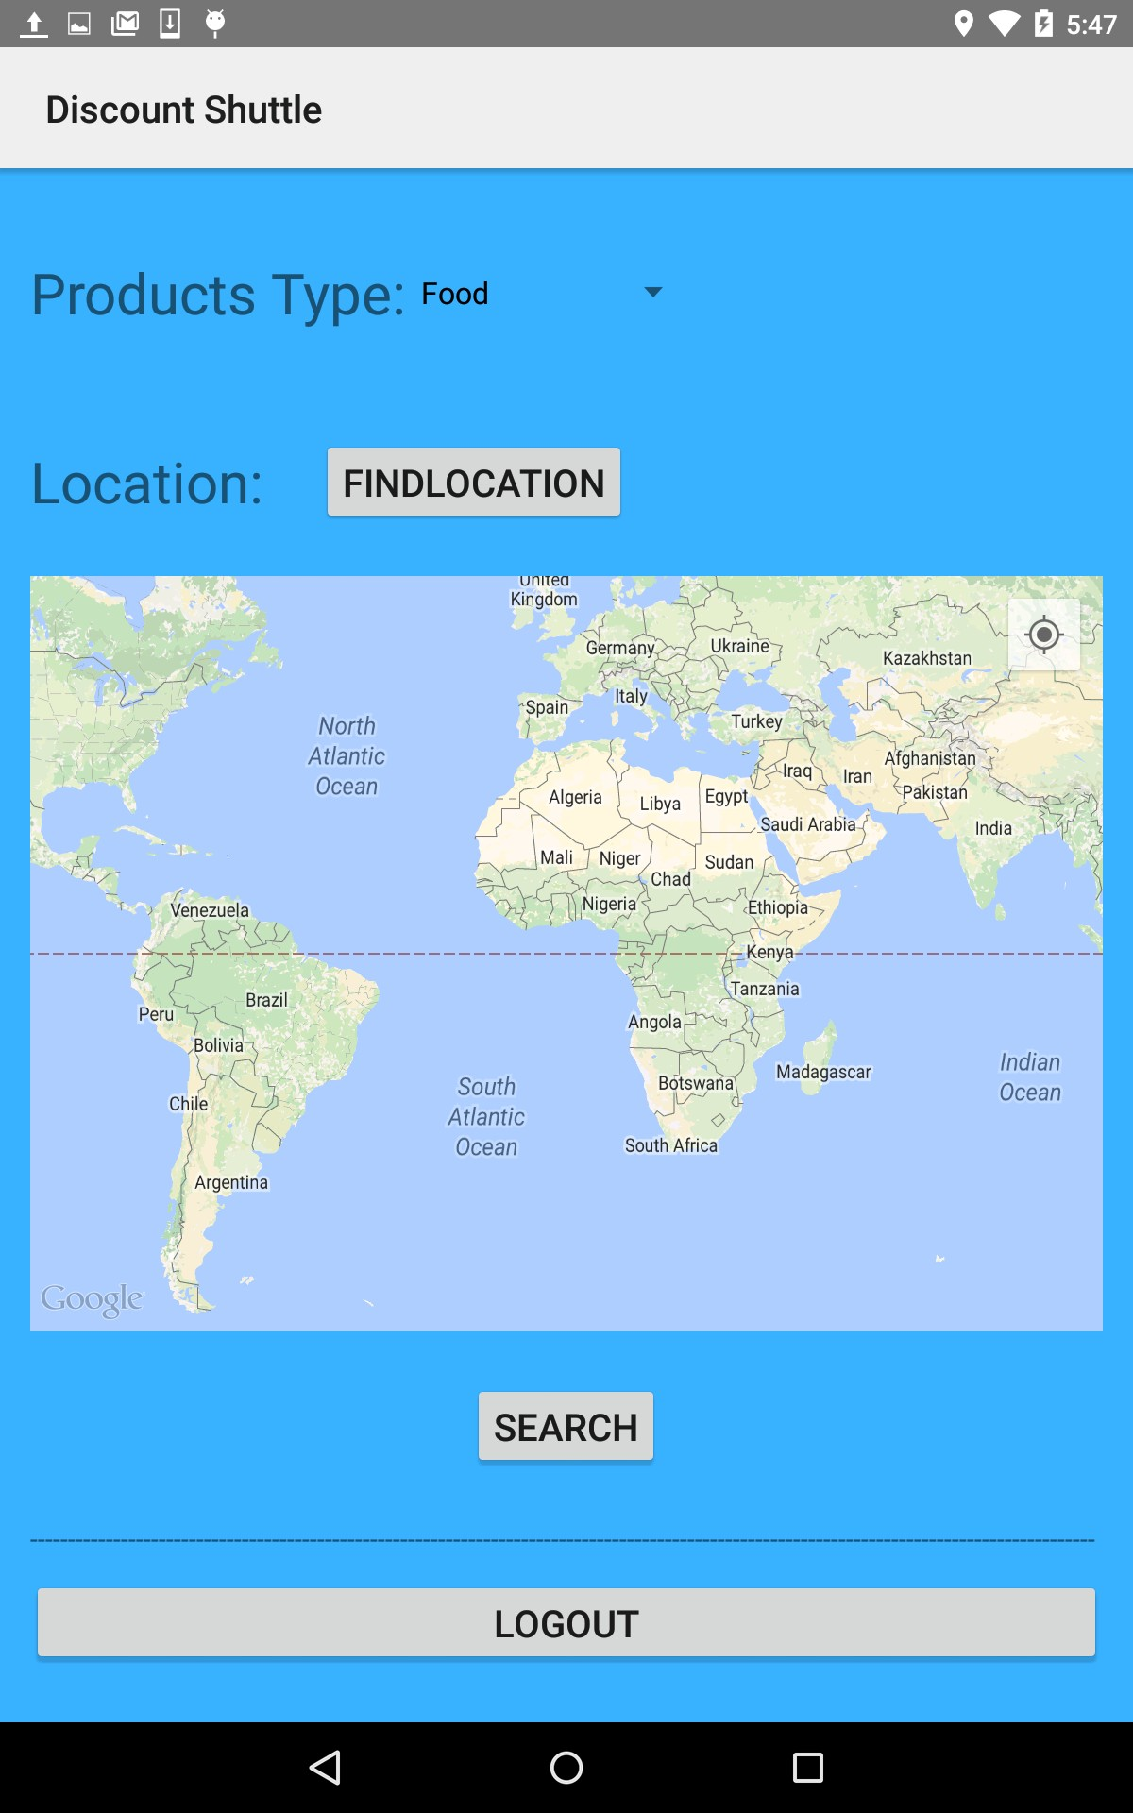
12.Guest Main page:

Slide 16
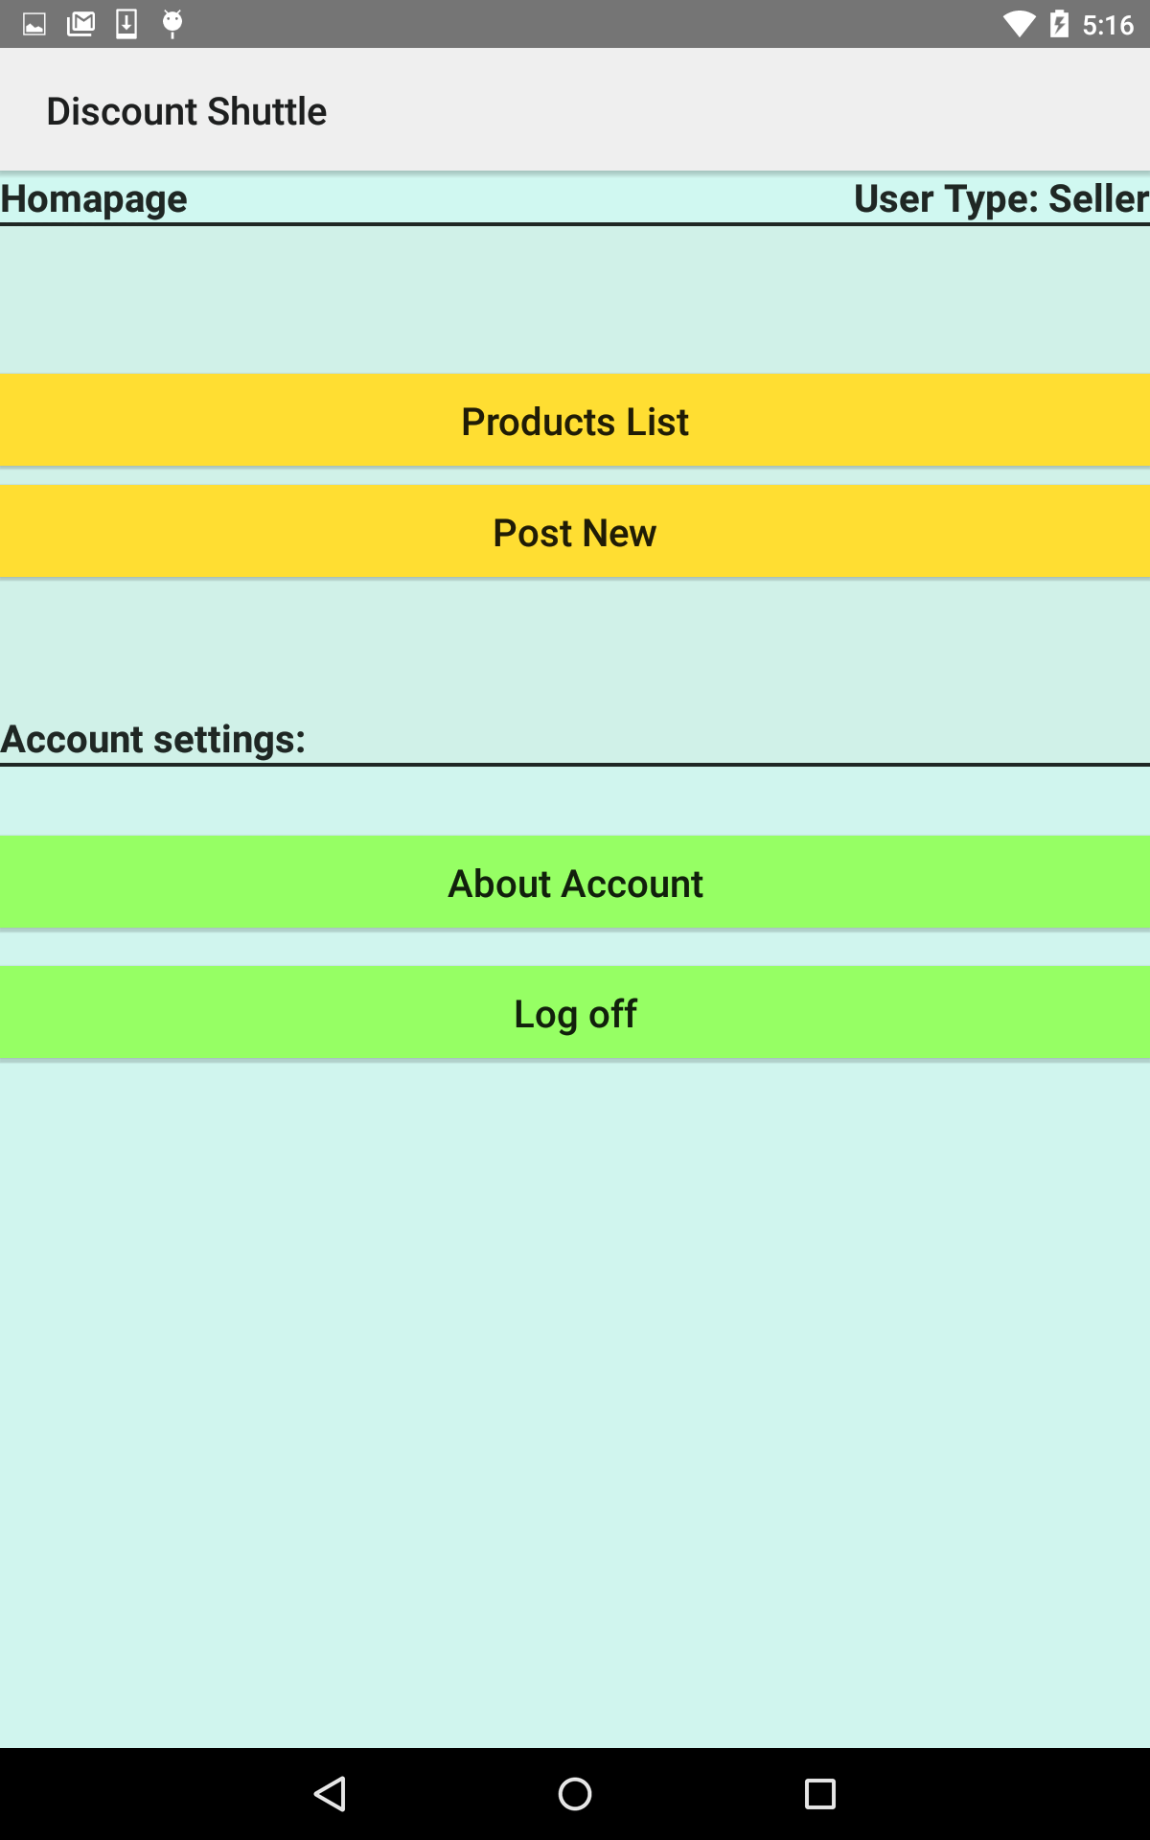
13.Seller Main page:

Slide 17
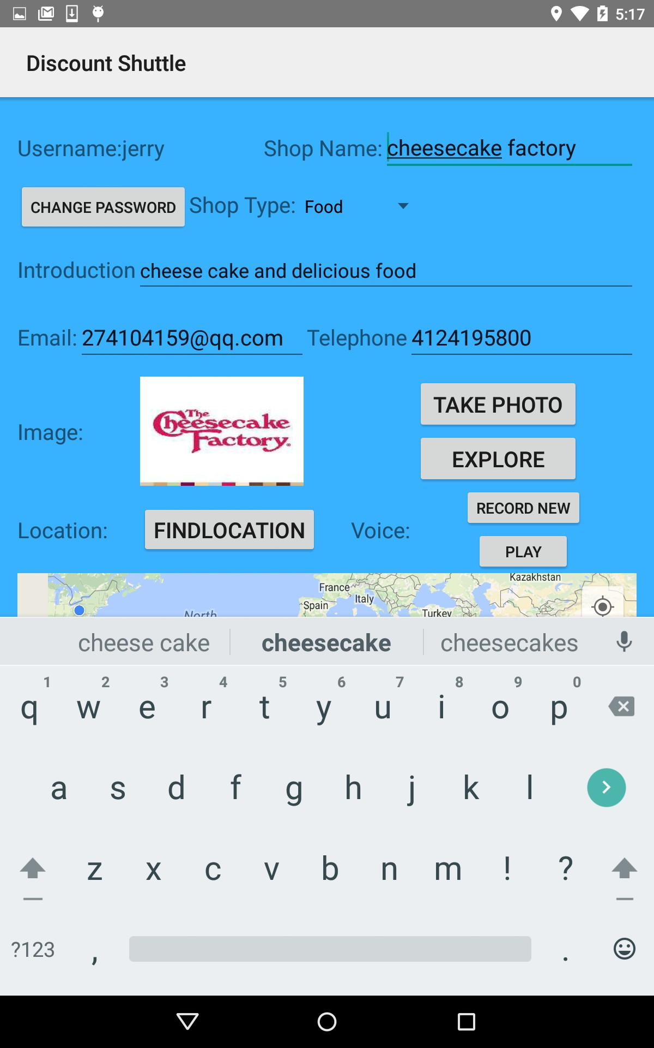
14.Seller Account page:

Slide 18
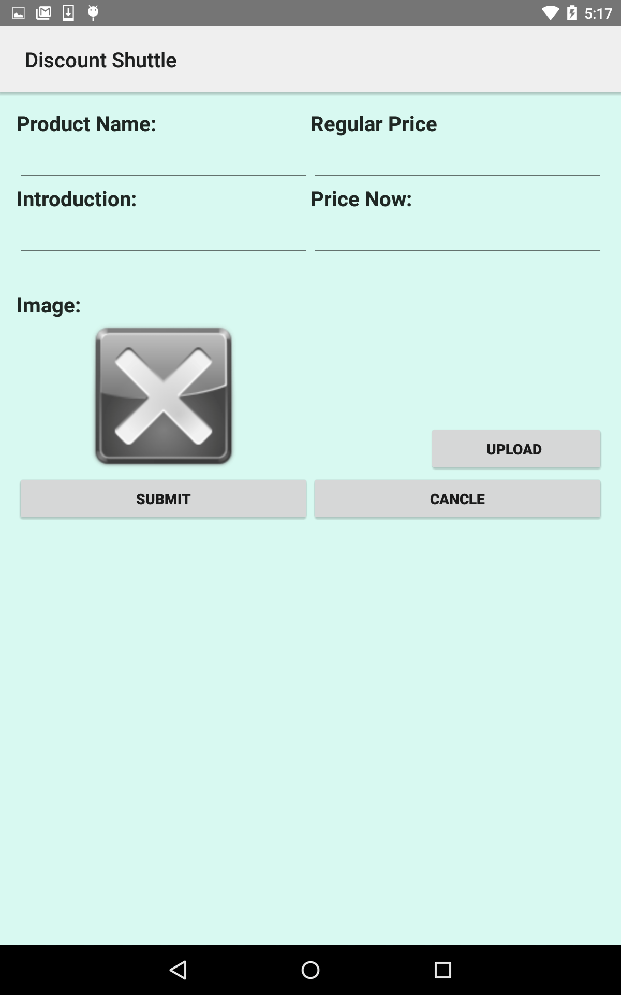
15.Seller Post new page:

Slide 19
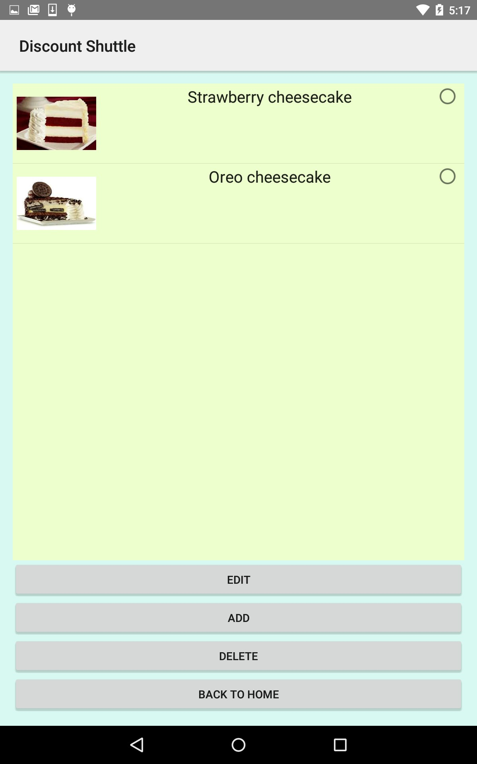
16.Seller Discount Manage page:

Slide 20
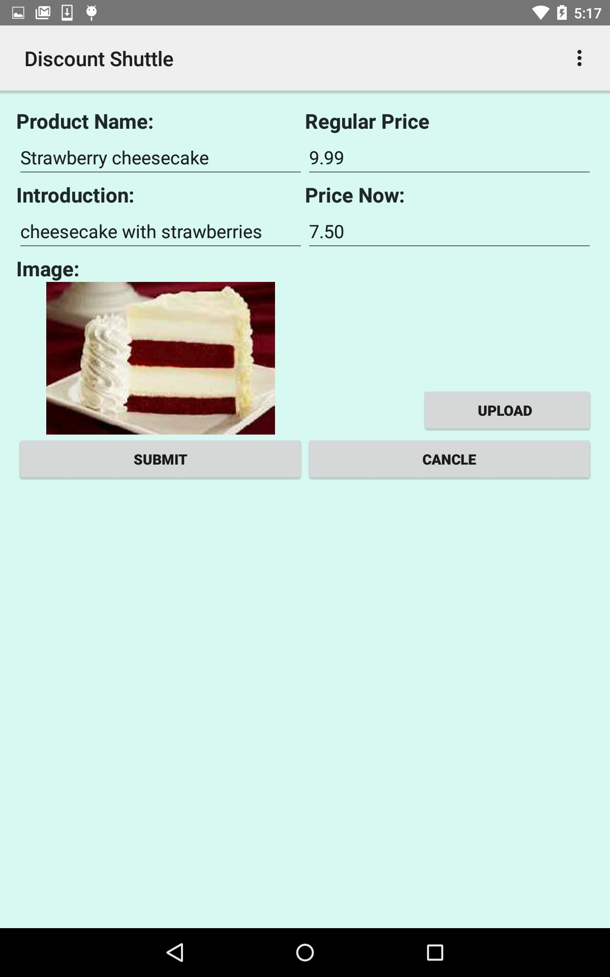
17.Seller Discount Manage page:

Slide 21
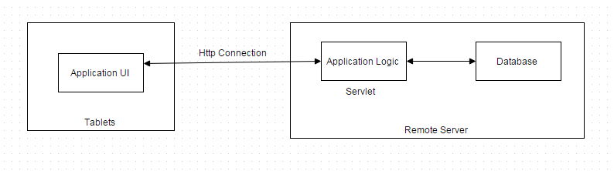
Overall relation of three tiers
Design Review

Slide 22
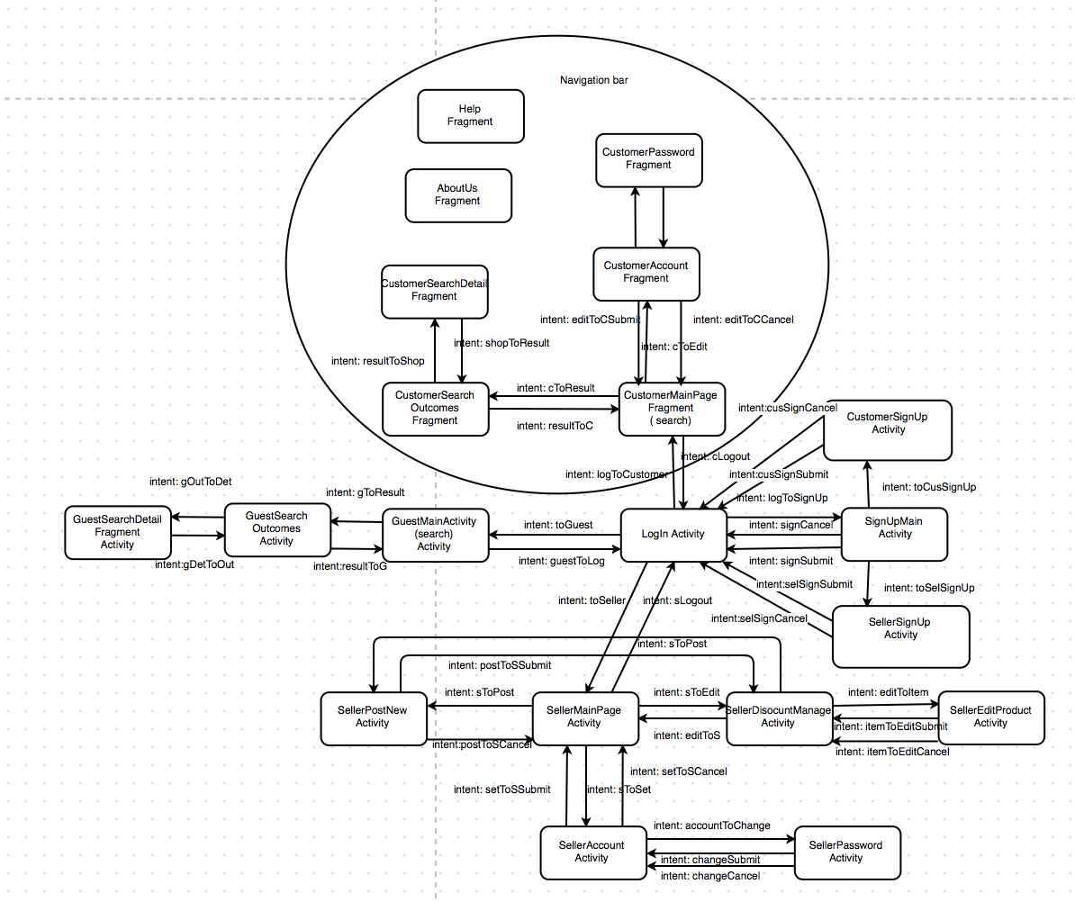
Presentation tier
Overall page flow

Slide 23
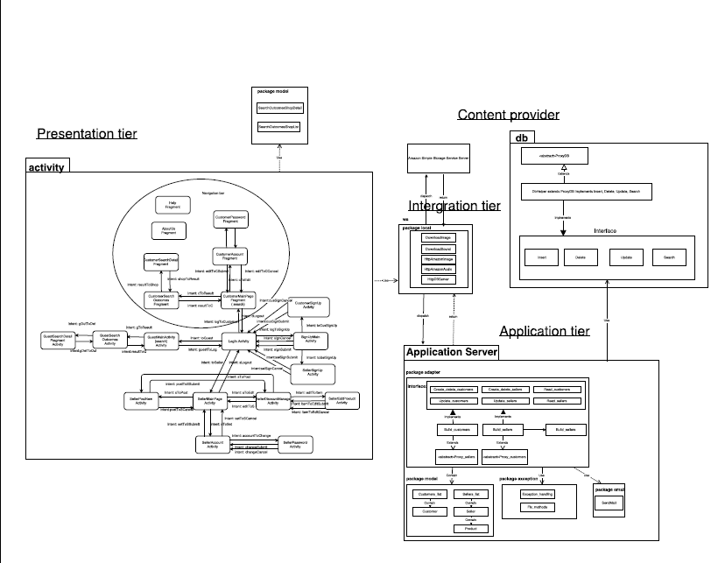

Slide 24
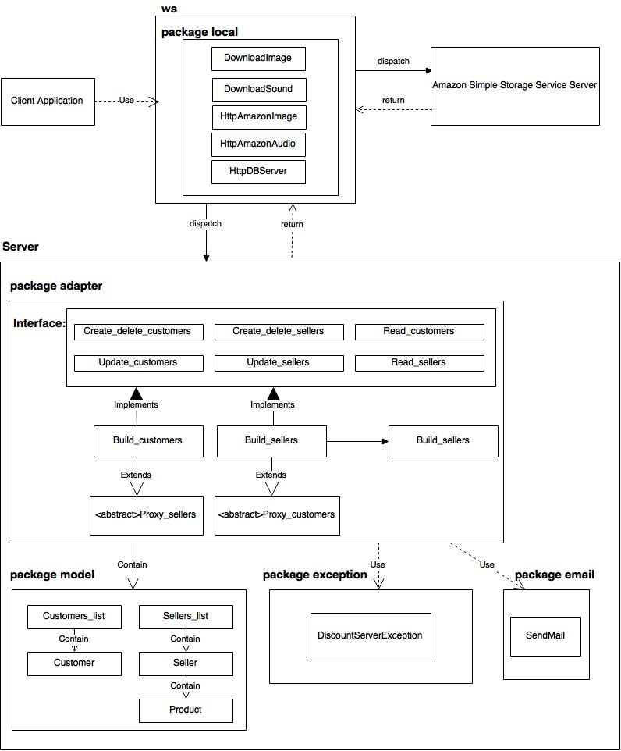
Application tier

Slide 25
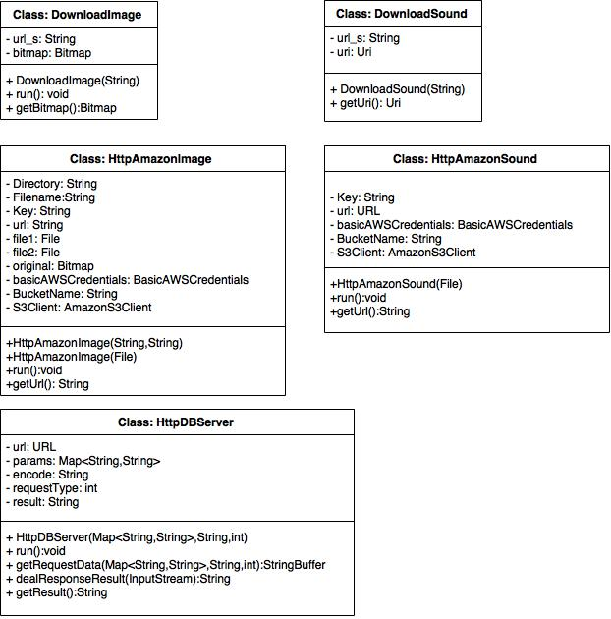
Web service

Slide 26
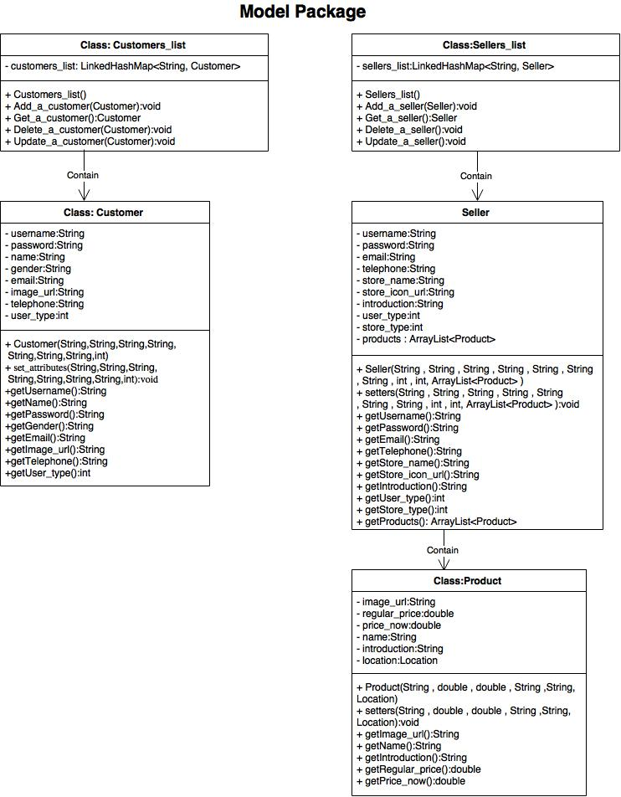
Model package

Slide 27
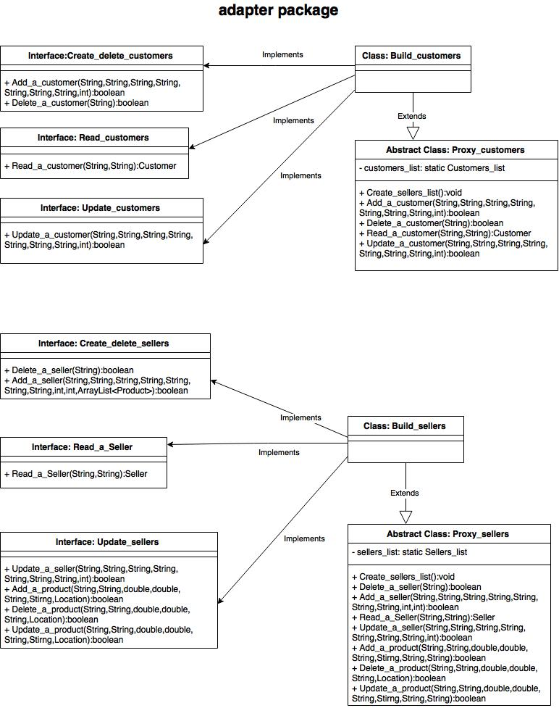
Adapter package

Slide 28
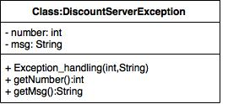
Exception

Slide 29
Database tier 1. Requirements

Slide 30
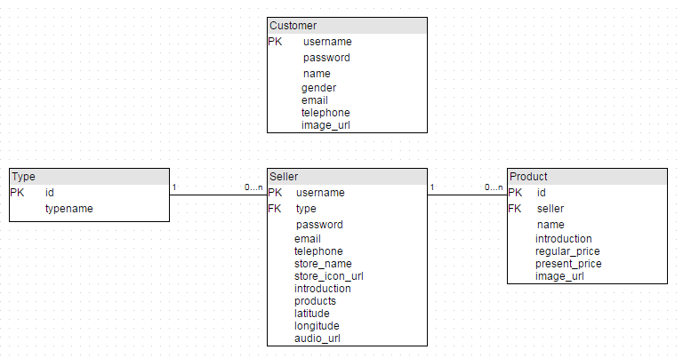
2. Logic data model
A seller may have several products. A seller may be assigned to a type.

Slide 31
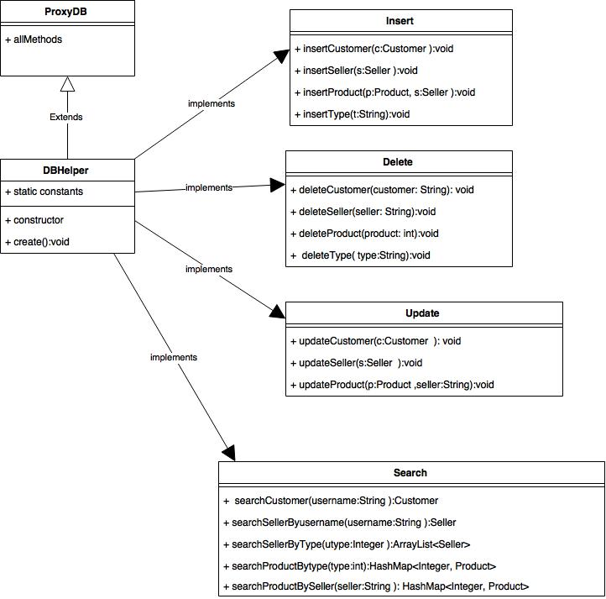
3. Database implementation and its operations

Slide 32
Lessons Learned
1. CRDU interfaces learned from project 1 was applied. At server side, there are CRDU interfaces for both customer user and seller user.
2. Abstract class design conception learned from mini 1 was applied for encapsulation. In adapter package, there are Proxy_customer.java and Proxy_server.java abstract classes which actually implements all the CRDU interfaces.
3. Exception class was installed to react in exception situation caused by requests from client side.
4. Exception handling mainly focuses on how to respond the client app if the request
5. There is a servlet package containing servlet classes for interacting with client app.
6. Network operations in an android application must be implemented in a thread class, and main activity should not be stopped to wait for a thread.
7. To implement the interaction and message transfer between main activity and thread, we can use Handler class in main activity. Handler can react accordingly when it receives message from a thread.
8. CRDU interfaces in adapter package can use methods provided by db package to interact with database.
9. There are several kinds of database, including five main types, such as flat, network, hierarchical, relational and Object-oriented.
10. In this team project, we use relational database. Relational database is an information system that presents information as rows contained in a collection of tables, each table possessing a set of one or more one or more columns.
11. The first step is to collect requirements. The general requirements is to build a B2C plat form as an android application.
12. In this application, we have three kind of actors, seller, customer and guest. The guest does not need an account to be stored in the database, so that the database does not have such a table for guest.
13. Database designing shall obey three normalization rules.
14. Database will be manipulated through eclipse JDBC. As a consequence, we must provide methods for CRUD functionality.
15. For the convenience of maintenance, the SQL query are stored in a property file and loaded when needed.

Slide 33
Product Demo
This is the link of the video showing how to use our product

